Slide 1
Indie Game Web Business
CIS 270
Alex Zheng
A proposed system for organizing upcoming indie game releases, developer submissions, visitor search, comments, reports, and notifications.
CIS 270 Final Project | 1

Slide 2
Problem Definition
Why the system is needed
Indie game release information is often spread across several websites and posts.
Visitors may miss release dates, price updates, or platform details.
Developers need a simple place to submit release information for review.
Administrators need basic tools for approval, reports, moderation, and notifications.
Main Objectives
Keep release data in one place.
Support developer accounts and submissions.
Let visitors search, like, comment, and report.
Send useful release and status notifications.
CIS 270 Final Project | 2

Slide 3
Feasibility Assessment
Economic, technical, operational, legal, and political feasibility
Economic Analysis - Budget
Technical Analysis
One-time estimate: $535
Recurring estimate: $100/month
Uses standard web hosting, database, browser testing, backups, and notifications.
Operational Analysis
Legal and Contractual Analysis
The screens are simple enough for visitors, developers, and administrators.
Needs clear terms, privacy notice, copyright review, and moderation rules.
Political Feasibility: verified profiles and moderation help reduce concerns about fake listings and negative comments.
CIS 270 Final Project | 3

Slide 4
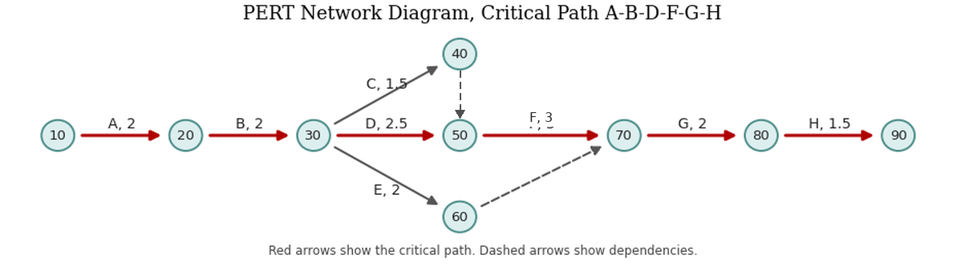
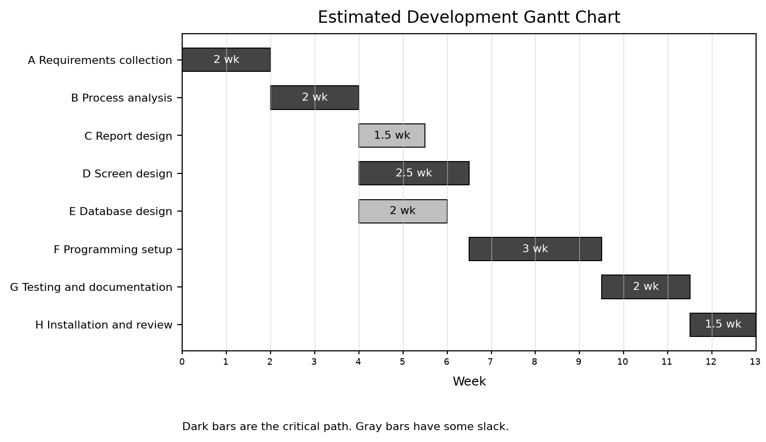
Pert/Gantt charts
Estimated schedule and critical path
Critical path: A-B-D-F-G-H
Estimated development work: 13 weeks.
Dark bars show the critical path.
Gray bars show activities with some slack.
PERT shows activity order and dependencies.
CIS 270 Final Project | 4

Slide 5
System Description
What the new system does
Developer submits game details and account information.
Visitor searches upcoming releases and interacts with listings.
Administrator approves submissions and reviews reports.
Notification service sends request/status messages.
Main Data Stores
Developer Accounts
Games
Community Activity
Reports
The design keeps the first version small enough for a class project while still matching the required system analysis sections.
CIS 270 Final Project | 5

Slide 6
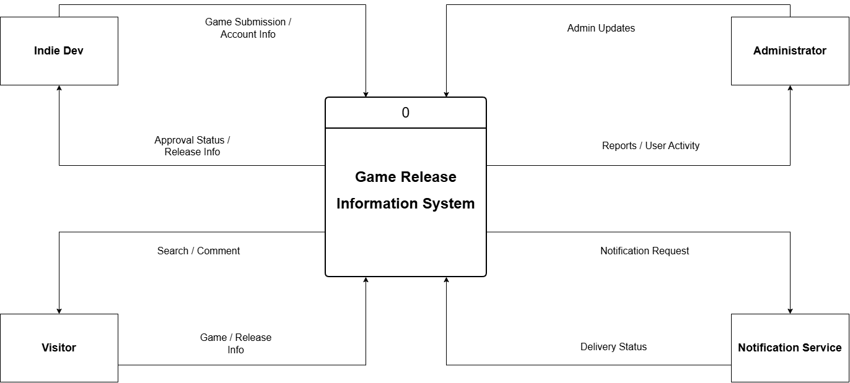
Context Level Diagram
System boundary and outside entities
CIS 270 Final Project | 6

Slide 7
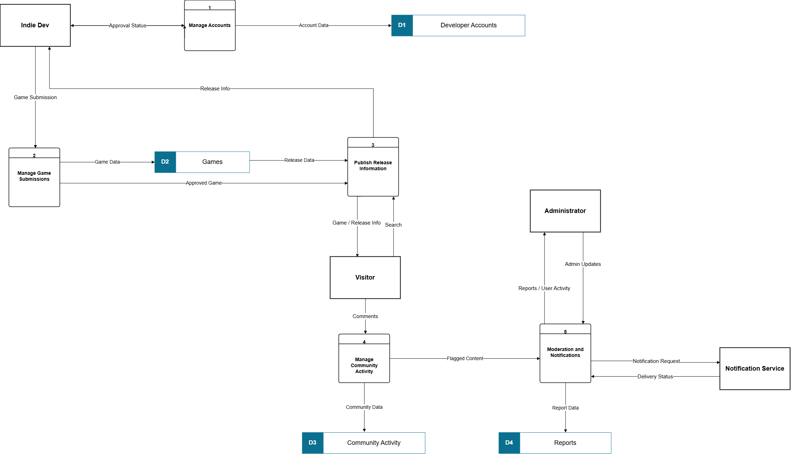
Level 0 Diagram
Five main system processes
CIS 270 Final Project | 7

Slide 8
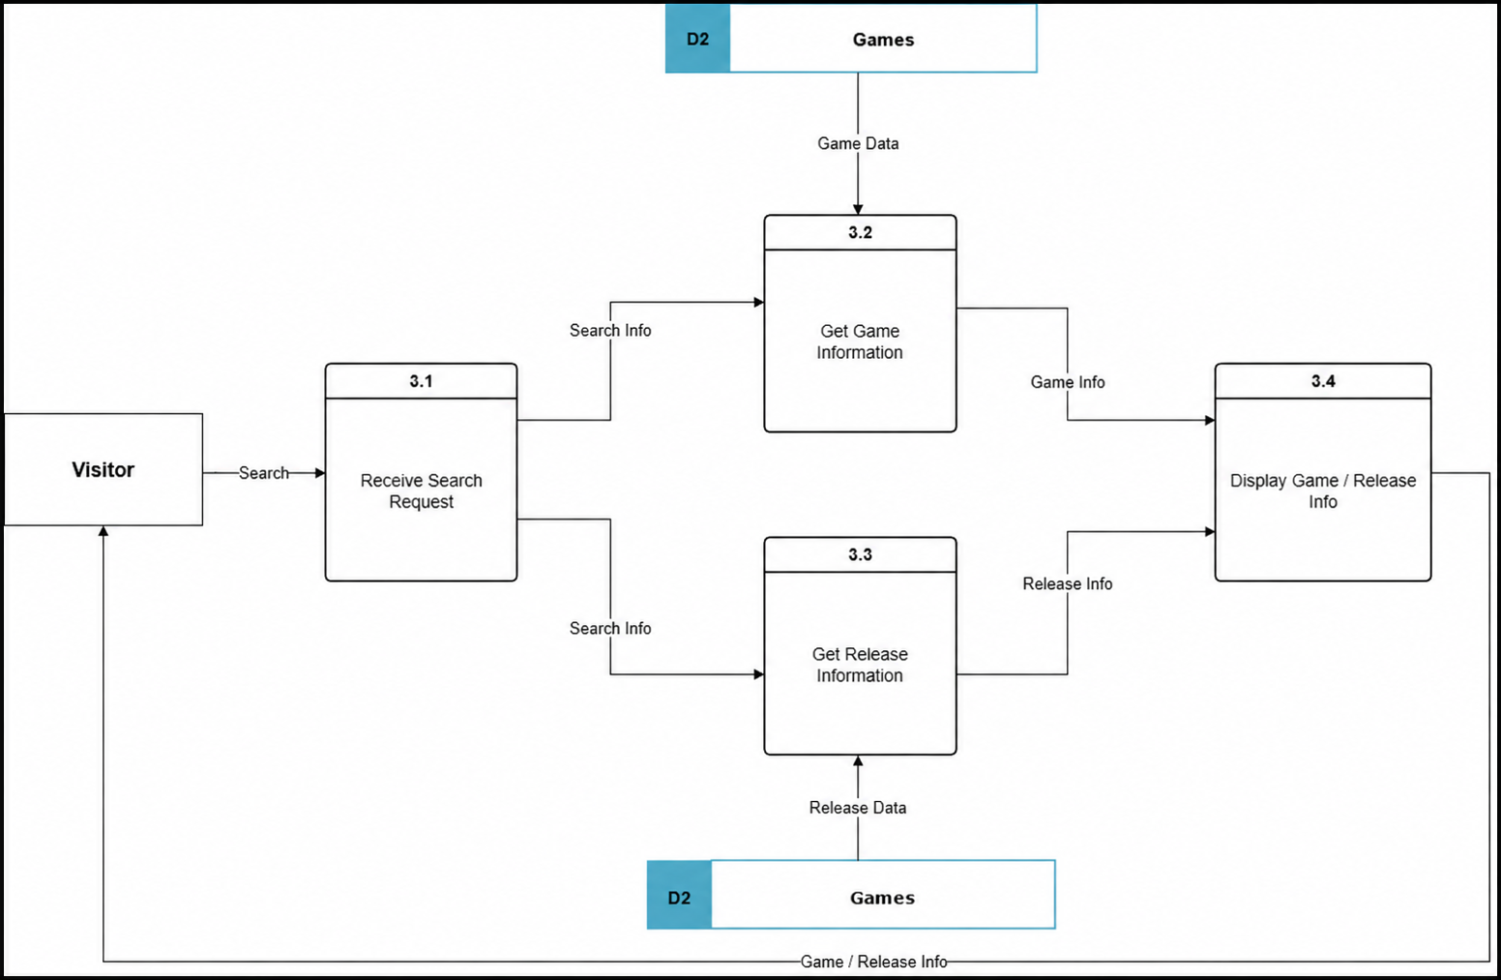
Level 1 Diagram for each process on the Level 0 Diagram
Presentation example; the report contains all five
Example shown: Publish Release Information.
The report also includes Manage Accounts, Manage Game Submissions, Manage Community Activity, and Moderation and Notifications.
Labels are kept simple so the diagrams look like normal Draw.io work.
CIS 270 Final Project | 8

Slide 9
Two Sample Reports
Simple staff reports, not dashboards
Report 1: Upcoming Release Schedule
Game | Platform | Release date | Status
Moonlight | Steam | Sept. 12, 2026 | Approved
notCraftMind | Switch | Sept. 18, 2026 | Needs price check
Garden | itch.io | Sept. 21, 2026 | Pending review
Report 2: Community and Moderation Summary
Game | Comments | Likes | Reports
Moonlight | 23 | 156 | 0
notCraftMind | 12 | 89 | 1
Garden | 5 | 44 | 2
CIS 270 Final Project | 9

Slide 10
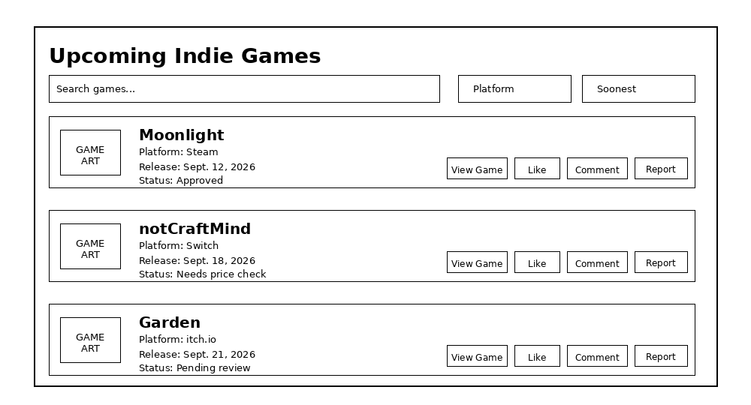
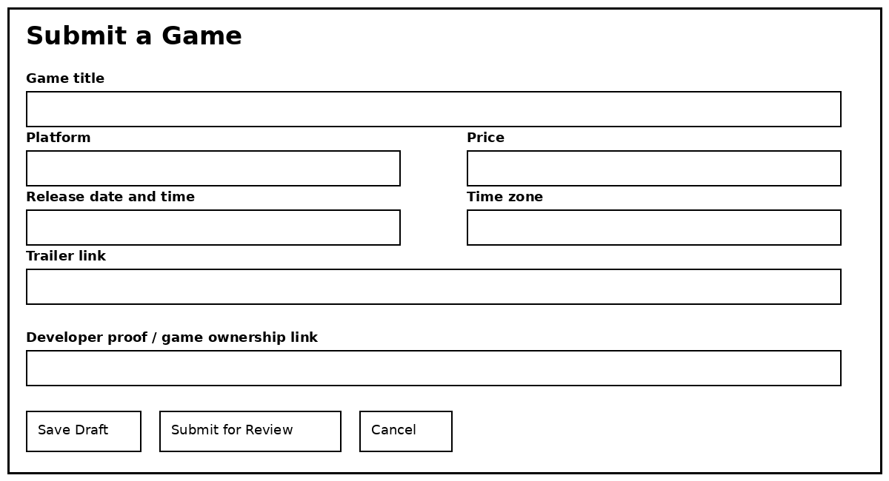
Two-Sample Screen Displays of the new system
Basic screen prototypes
Screen 1: Upcoming Indie Games
Screen 2: Submit a Game
CIS 270 Final Project | 10

Slide 11
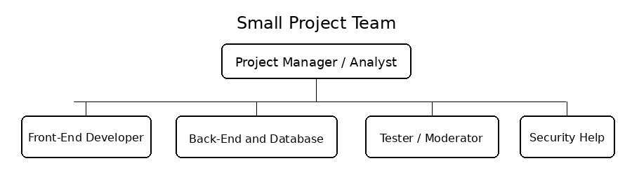
Management Issues
Team configuration, communication, and standards
Communication Plan: short team check-ins and weekly progress notes.
Project Standards & Procedures: consistent names, simple diagrams, backups, and tested changes.
Other Project – Specific Topics: avoid scope creep and keep moderation rules clear.
Final recommendation: continue with the small first version, then improve the system after feedback.
CIS 270 Final Project | 11

Slide 12
Works Cited
Kendall, Kenneth E., and Julie E. Kendall. Systems Analysis and Design. 11th ed., Pearson, 2020.
Cloudflare. “Pricing - R2.” Cloudflare Docs, https://developers.cloudflare.com/r2/pricing/. Accessed 7 Aug. 2026.
Cloudflare. “Pricing - Workers.” Cloudflare Docs, https://developers.cloudflare.com/workers/platform/pricing/. Accessed 7 Aug. 2026.
“Coming Soon and Release Dates.” Steamworks Documentation, Valve, https://partner.steamgames.com/doc/store/coming_soon. Accessed 10 Aug. 2026.
“Game Jolt.” Game Jolt, https://gamejolt.com/. Accessed 10 Aug. 2026.
itch.io. “About itch.io.” itch.io Docs, https://itch.io/docs/general/about. Accessed 11 Aug. 2026.
Indie DB. “About Us.” Indie DB, https://www.indiedb.com/about. Accessed 14 Aug. 2026.
Resend. “Pricing.” Resend, https://resend.com/pricing. Accessed 16 Aug. 2026.
Supabase. “Pricing & Fees.” Supabase, https://supabase.com/pricing. Accessed 18 Aug. 2026.
CIS 270 Final Project | 12

